Slide 1

Updating C2VSimFG Aquifer parameters using well completion reports (OSWCR) and geophysical data (AEM) in the Central valley Basin
Behrooz Etebari; MS; PG
Thi Pham; GIT
11/15/2024

Slide 2
Objectives
Update C2vSimFG aquifer Parameters with New data
Any change in the model thickness= new estimates of aquifer parameters
Calibrate the model with multiple realizations of aquifer parameters from input data using python coding & ArcGIS Pro tools(geostatistical methods)

Slide 3
Well Completion Reports
Geophysical surveys
OPEN DATA/OSWCR
OPEN DATA/Ramboll well completion reports
AEM coarse Fractions
E-Logs
(CalGEM)
SVSim
C2VSimFG
Geologic Logs Free Form
Geologic Logs Quick Pick
Shallow to medium
Max 1200’bGS
Geologic Logs USCS/ASTM
Deep enough 50’ bGS-10,000’bGS
Geologic Logs General Lithology
tif files/Need digitization

Slide 4
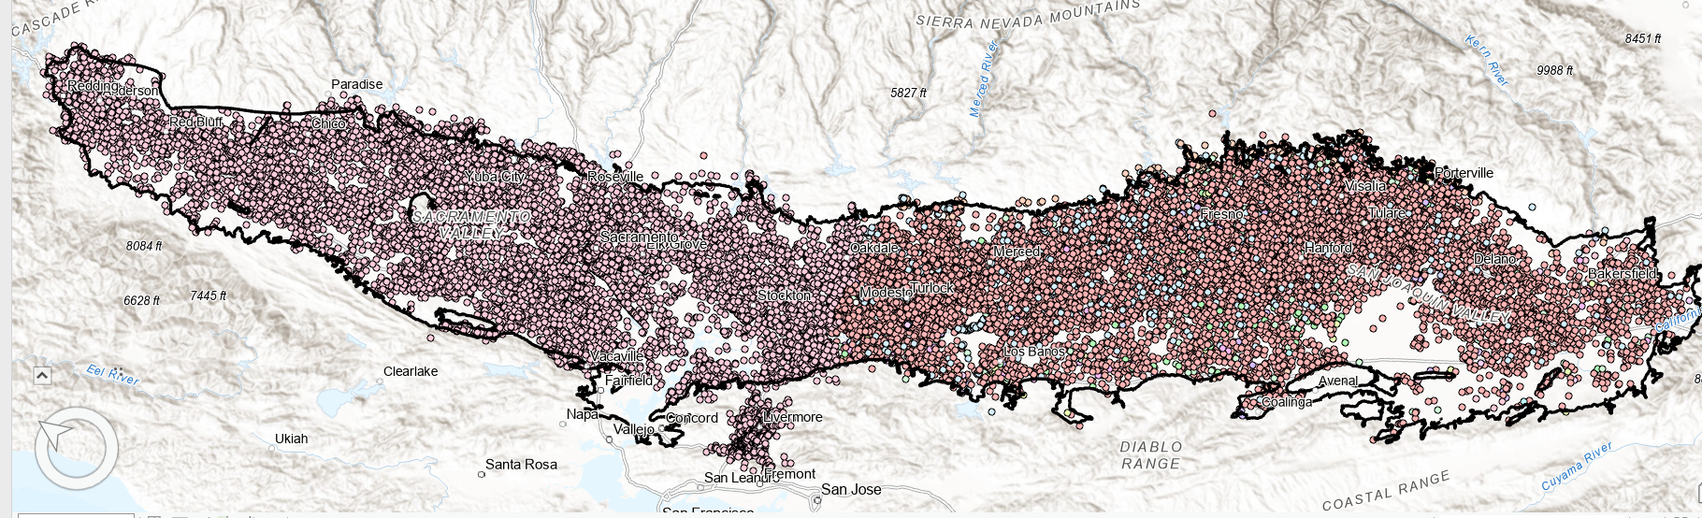
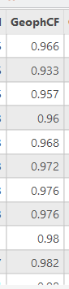
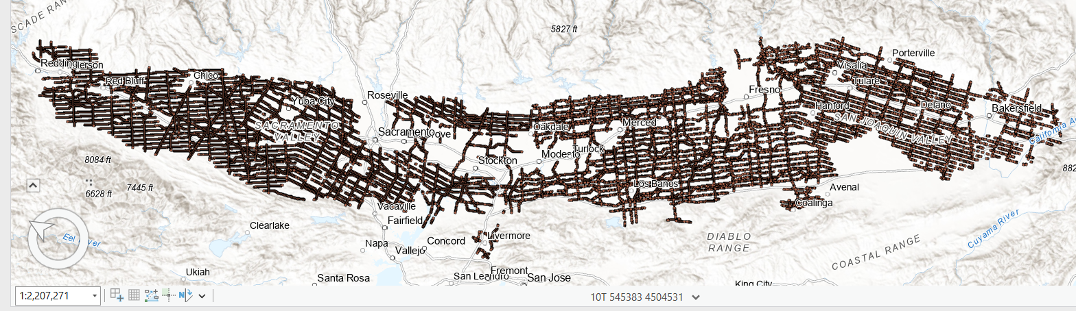
Ramboll newly Well completion reports
Coarse Fraction points for AEM flight line

Slide 5
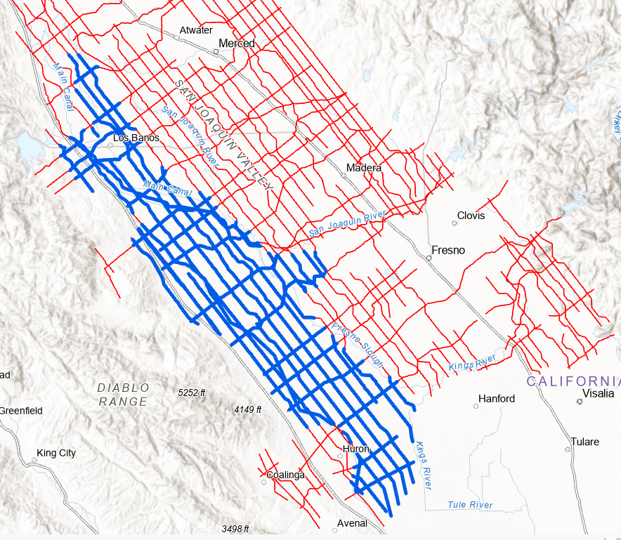
Blue Zone with distorted values(Low Resistivity Zone due to high GW TDS ), masked out from AEM datasets

Slide 6
WCRs and Geophysical Survey Analysis
OPEN DATA/OSWCR : 23,633 Ag-Wells
GeologicLogs Free Form (21,412 Ag-wells)
GeologicLogs Quick Pick (1,772 Ag-wells)
GeologicLogs USCS/ASTM D2488 (Ag-642 wells)
GeologicLogs Generalized Lithology and … (180 Ag-wells)
OPEN DATA/Ramboll supporting WCRs: (16,908 Ag-Wells)
Survey Area 4
Survey Area 5
Survey Area 6
Survey Area 7
AEM coarse Fractions (264,929 points; = 6,867,907 records)
SVSim Wells +Levees (4,691Ag-Wells)
C2VSimFGV1.01 2015; (10,469 Wells; original data is not available)
Total new: 315,819; 8,032,131 records

Slide 7
Challenges Encountered
Data consistency issues:
Typos (Clayy , Chay, shail , Shist, gravl , sanston , dg, d/g, etc.)
Existing USCS classification with inaccurate names
Creating Key words based on USCS-ASTM
Data standardization:
Multiple resources= multiple coding efforts = make them uniform
Mapping to new rock types:
SHLE, SDST, STST, VFRG, GRNT, BSLT, CONG, SCHT, META, IGNS, VOLC etc.
New columns for color and texture:
SOIL Description= new columns for Color and Texture

Slide 8
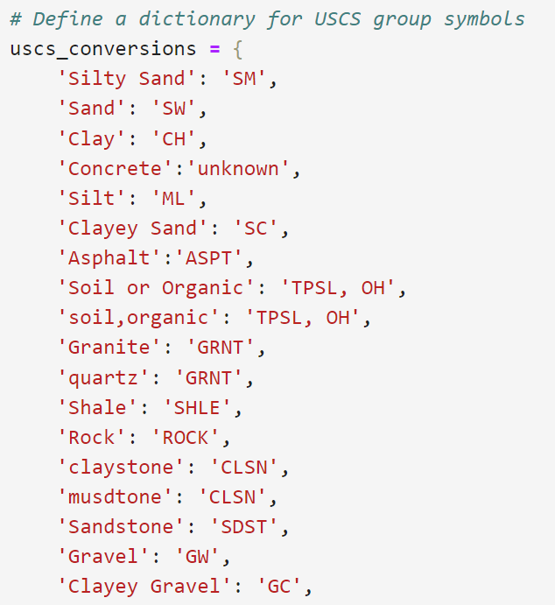
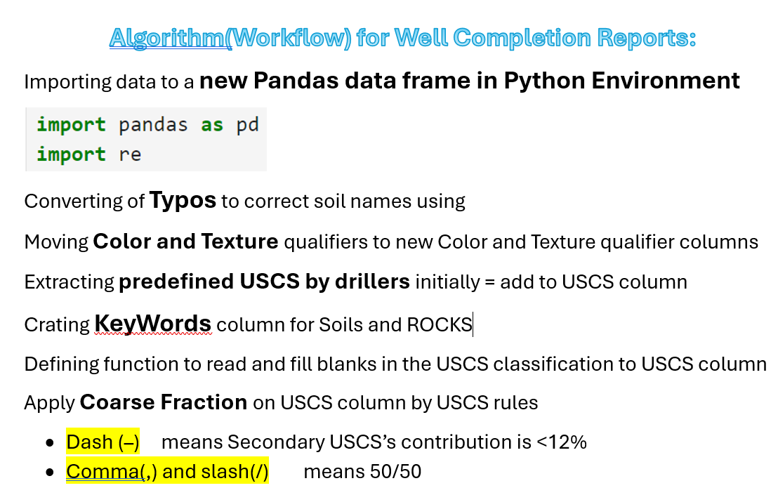
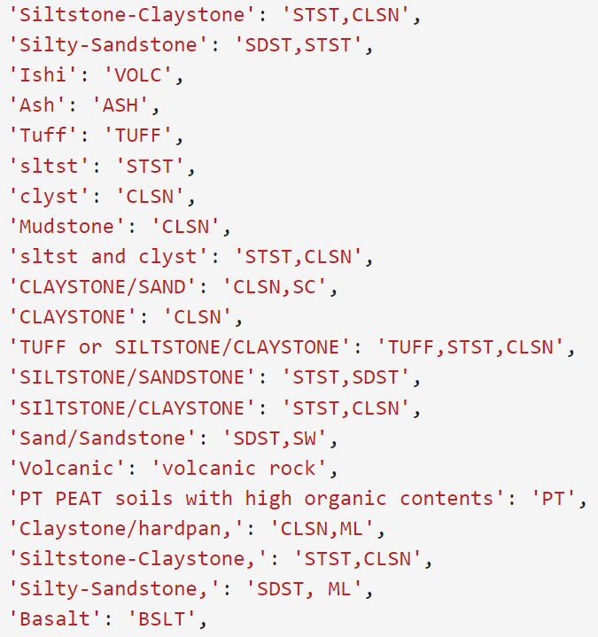

Slide 9
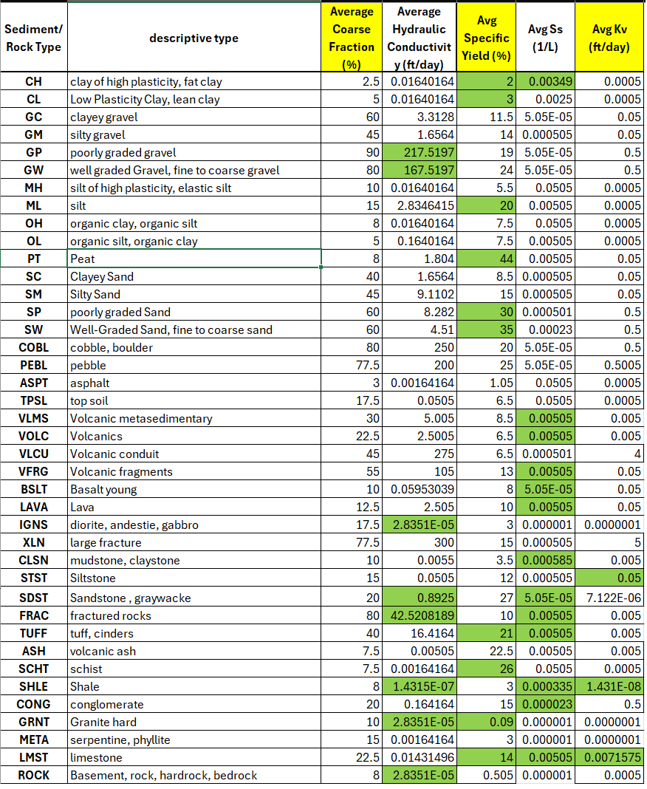
Hydraulic Properties; Aquifer Testing 101:
Representative Values of Hydraulic Properties
http://www.aqtesolv.com/aquifer-tests/aquifer_properties.htm

Slide 10
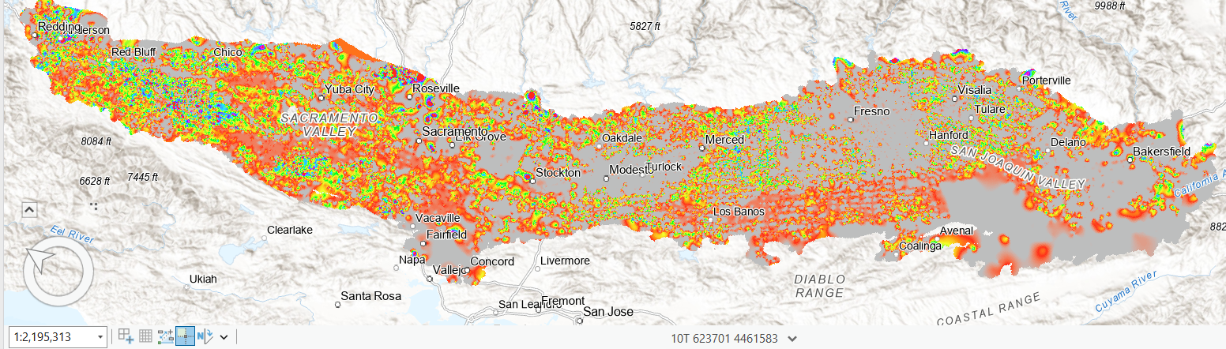
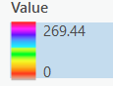
One realization of Hydraulic Conductivity (Kxy); depth <25’ bGS; units ft/d

Slide 11
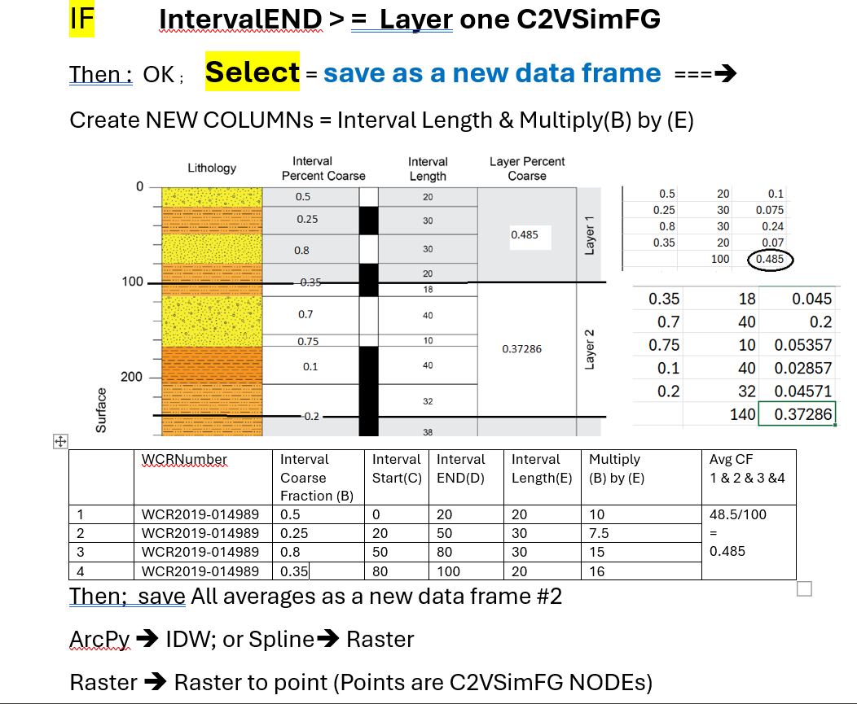
Methodology to condition model nodes(Layer 1; C2VSimFG1.5) with new analyzed Kxy data

Slide 12
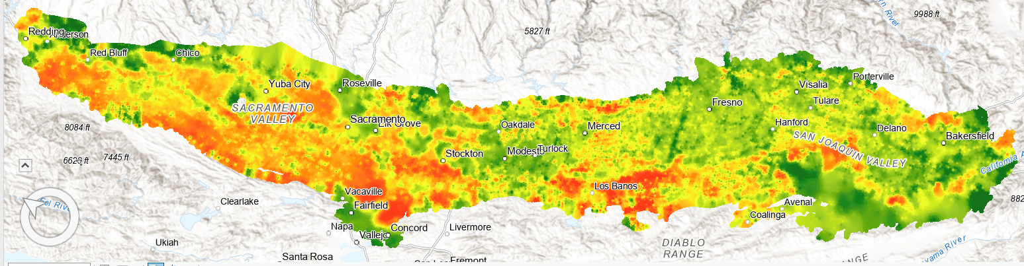
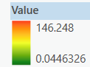
Average of Hydraulic Conductivity (Kxy)
C2VSimFG Layer ONE

Slide 13

behrooz.etebari@water.ca.gov
(916) 281- 8346
Tools on GitHub :
https://github.com/BehroozEtebari-DWR/Well_logs2Aquifer_Params
https://github.com/BehroozEtebari-DWR/SpecificCapacity2Transmissivity

